Slide 1

School Choice
CSCI 39575 Graph Theory
By Ariel Avshalom

Slide 2



School…where do we stand?
Once upon a time, very few people went to school
Those who did usually went in their late teens and came out with a Bachelor’s before hitting twenty
They also came out with more opportunities and knowledge than most of the people in our nation

Slide 3


But…things change
With the drive to increase literacy rates
Eventually, schooling which was a privilege few could afford became free
People were able to go to grade school and eventually secondary school
That changed even further when President Lyndon B. Johnson’s congress passed the Elementary and Secondary Education Act of 1965

Slide 4
The Higher Education Act of 1965
Eventually the goal was that colleges should be open to anyone who wants an education
The government fronts the money and students could go to virtually any school that accepts them
But…with that, the schools decided to strategize and started raising their prices ridiculously
Once upon a time, two bushels of wheat were enough for a course at Harvard (1950s)
Now, the cost is…well…A LOT
Notes:
Two bushels of wheat cost 5$ back then

Slide 5
The value of an education…
Now that so many people have a college degree, it has become a requirement of many jobs
Just like once upon a time, a high school diploma was enough
And before that, basic literacy
But the costs just keep on increasing
To be fair, the cost of living and the amount of stuff we own has also increased by leaps and bounds since the 50s, but not in the same way as a university degree

Slide 6

Another problem arises
Where once there were an abundance of seats to fill, going to school has become a competitive endeavor for students
So many people want to go to the “best” institutions…
And now those universities and primary/secondary schools have become highly selective
And suddenly, an interesting scenario arose
SCHOOL CHOICE

Slide 7
A historical context
K-12 students historically went to their local schools
School choice programs allowed students/families* to express preference over schools
*The backseat driver of all of this
The goals of such an assignment mechanism started to emerge and they were:
Efficiency: satisfying students’ preferences as well as possible
Fairness
Simplicity: easy to use/understand
Strategy-proofness: it shouldn’t be gamed by its players

Slide 8

Some real world concerns
Strategic behavior of invested students/families became a real concern
Boston used to have a non-strategy-proof mechanism
Boston Public Schools superintendent Thomas Payzant: “A strategy-proof algorithm ‘levels the playing field’ by diminishing the harm done to parents who do not strategize or do not strategize well.”

Slide 9
Other “Advice”
St. Petersburg Times, 2003:
Make a realistic, informed selection on the school you list as your first choice. It's the cleanest shot you will get at a school, but if you aim too high you might miss.
Here's why: If the random computer selection rejects your first choice, your chances of getting your second choice school are greatly diminished.
That’s because you then fall in line behind everyone who wanted your second choice school as their first choice. You can fall even farther back in line as you get bumped down to your third, fourth and fifth choices."

Slide 10
Other “Advice” (2)
2004-2005 BPS Guide
"For a better choice of your `first choice' school...consider choosing less popular schools."
West Zone Parents Group Meeting
One school choice strategy is to find a school you like that is undersubscribed and put it as a top choice,
find a school that you like that is popular and put it as a first choice and find a school that is less popular for a `safe` second choice."
OR,
Notes:
Hurts less-informed students who do not know how to game the system.

Slide 11

Boston mechanism
Each student submits a preference ranking
The top choices of students are considered
For each school assign seats to students that ranked it first according to school’s priority
Stop if all seats assigned or exhausted students who picked this school first
Repeat by considering remaining students and their second choices

Slide 12
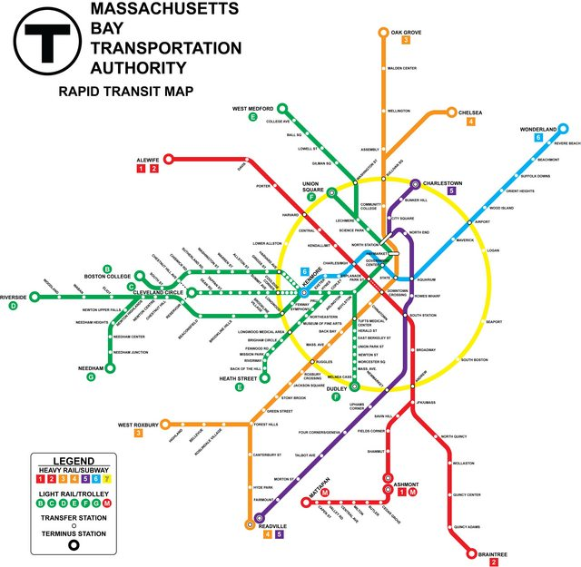
Boston’s problems
Like school choice, Boston’s Metro needs some work…
If you don’t put your priority school high on the rank list, you may not get in
3 schools, A, B and C
Student S wants to really go to A then B and finally, if there is no other choice C
A is filled without S, so he’s put at the end of B’s list and he misses out there as well
If B was his first choice, he would’ve gotten in, instead he went to C
Notes:
But to be fair, so do many other metros…

Slide 13
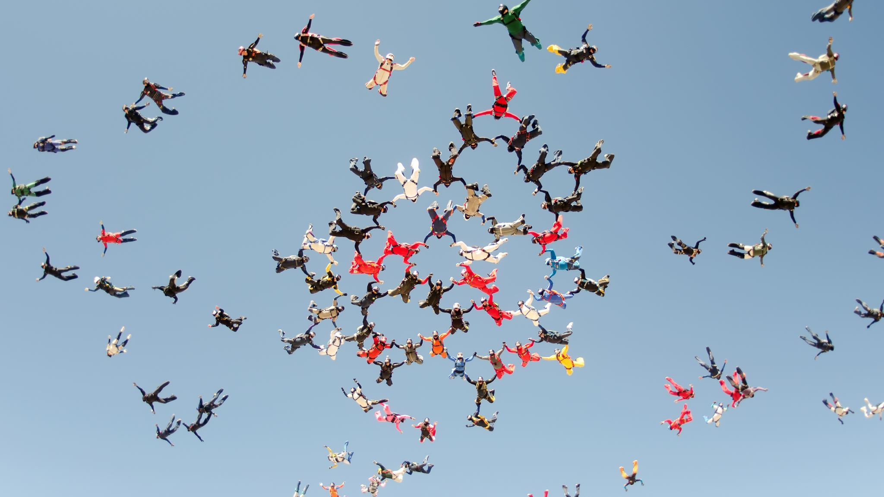
Is this stable and what is stability?
No
Look at the previous example, S might have really preferred A but he didn’t rank high enough to go there
But he would’ve been accepted to B if he applied there first
Instead, he went to a school he is not happy with
If B could, it would try to accept S in lieu of a student who is less preferred to S which exists since S was put into the list after all first-choice candidates were considered

Slide 14
Columbus Ohio schools
Each student applies to up to three schools
For some schools seats are guaranteed based on location
Afterwards, a lottery determines other students’ fates
A student with an offer has 3 (!) days to decide
If they accept, they’re removed from the system
Process repeats until no more students

Slide 15
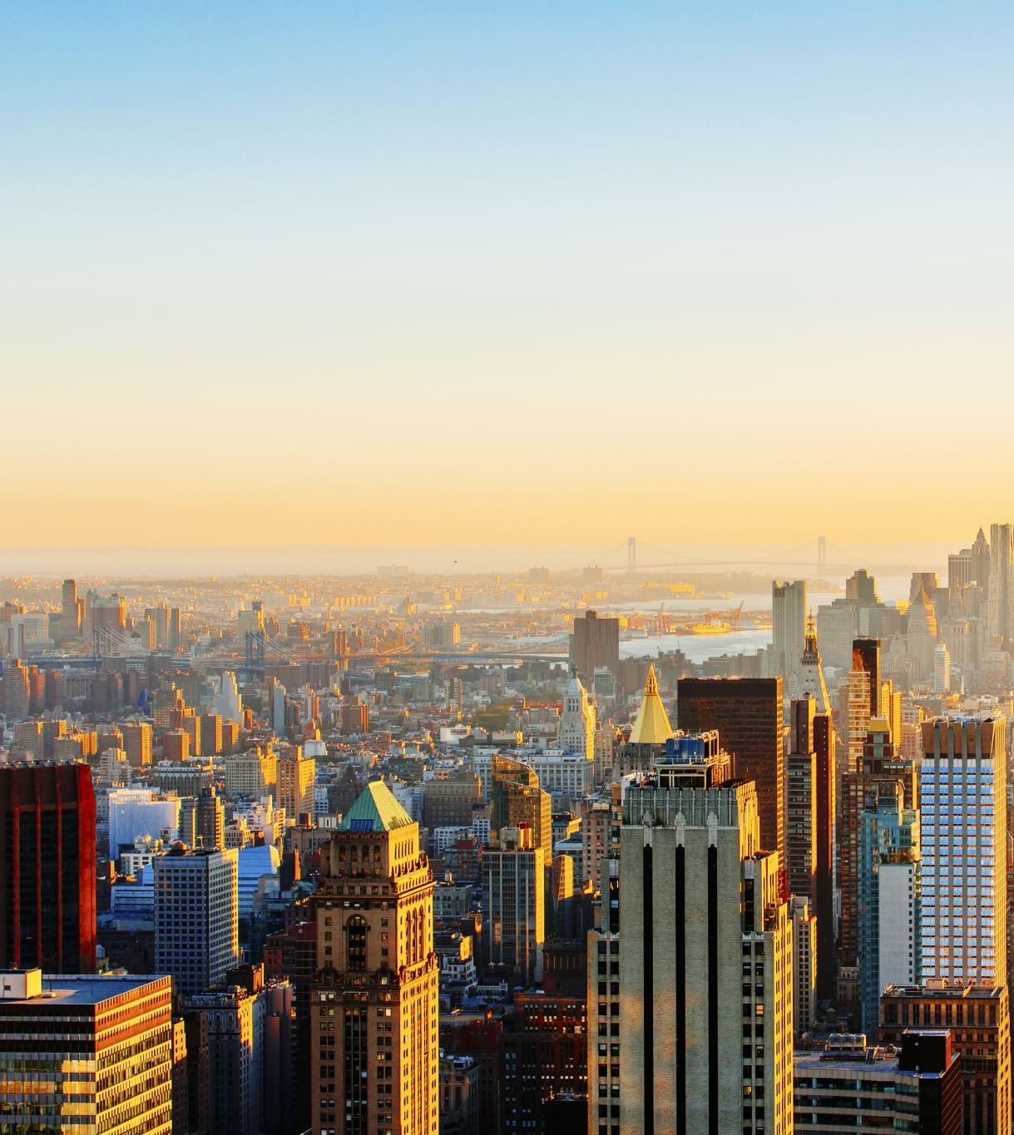

NYC
Hundreds of thousands of students submit up to five applications (over one million students in the high school system)
Each school receives applications, makes offers and creates a waiting list
Students accept/reject offers
Schools make offers from wait lists
Many students are unassigned at the end and get administratively assigned ($\sim \frac{1}{3}$ in one year of this system)
Notes:
Over 90000 applicants at the year I was looking at with 30000 unassigned

Slide 16
The issues
No individual rationality
No stability = justified envy
Not Pareto efficient
Not strategy proof

Slide 17


The model
The school choice market consists of
Sets A and S
A is the set of students $\{a_{1},…,a_{n}\}$
S is the set of schools $\left\{s_{1},…,s_{n}\right\}$
Each school has a positive integer capacity $C_{s}$
Each student $a$ has a strict preference $⇜_{a} over S \text{∪}\text{ \{}\text{∅}$*}
Each school s has a strict priority ordering $⇜_{s}$ over A
Notes:
The schools don’t necessarily need a strict preference of students

Slide 18

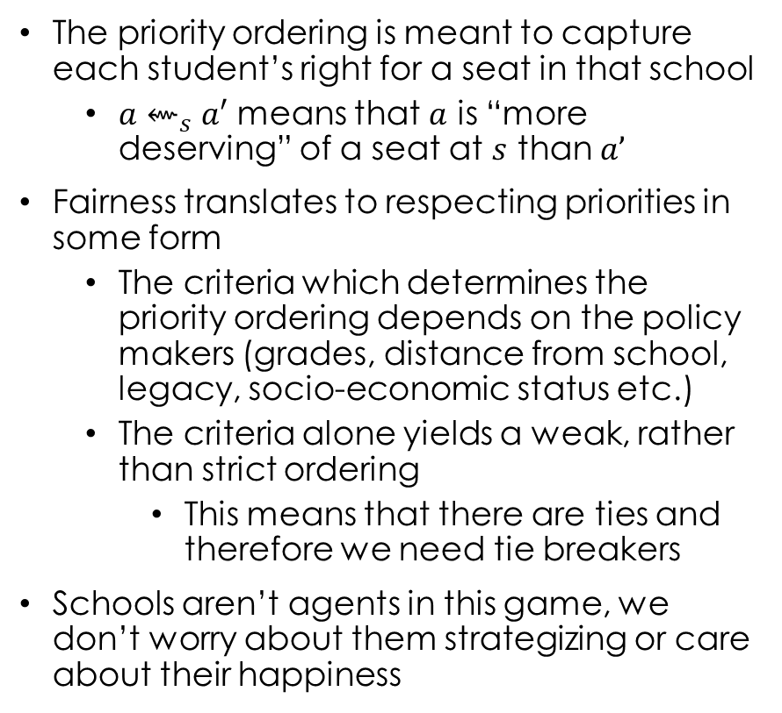
Priority ordering of the model
The priority ordering is meant to capture each student’s right for a seat in that school
${a⇜}_{s}a′$ means that $a$ is “more deserving” of a seat at $s$ than $a’$
Fairness translates to respecting priorities in some form
The criteria which determines the priority ordering depends on the policy makers (grades, distance from school, legacy, socio-economic status etc.)
The criteria alone yields a weak, rather than strict ordering
This means that there are ties and therefore we need tie breakers
Schools aren’t agents in this game, we don’t worry about them strategizing or care about their happiness

Slide 19

A match
Students are matched to some school in their list of schools
They do not get assigned to a school that they did not choose

Slide 20


No justified envy
We want our algorithm to “respect priorities”
One way to interpret that is stability
Stability of a matching $μ$ in this context would mean:
If $s⇜_{a} μ(a)$ then
$$\left|μ\left(s\right)\right|=c_{s}$$
$$Every student a^{′}∈μ\left(s\right) satisfies a^{′}⇜_{s} a$$
In other words, if a didn’t get a school they wanted, it’s because that school is full of students with higher priorities
This is known as no justified envy
Notes:
We sort of spoke about this when we did stable marriage. Mention WPDA and MPDA. When both are equivalent we have a stable matching.

Slide 21
Deferred acceptance (DA)
The simplest solution with no justified envy is student-proposing deferred acceptance (SPDA)
Recall: a DA matching is not stable if
an element of set A prefers some given element B of the second matched set over what A is already matched to
B also prefers A over the element to which B is already matched
Stability can be defined as
When there does not exist any match (A,B) which both prefer each other to their current partner under the matching
There always exists a stable matching, shown by the Gale-Shapley algorithm
Notes:
We covered Gale-Shapely during stable marriage, but I did not call it by that name.

Slide 22
An issue arises: pareto efficiency
Pareto efficiency is a situation where no individual or preference criterion can be better off without making at least one individual or preference criterion worse off or without any loss thereof
This doesn’t happen here…
Check this video on Pareto efficiency
This is also pretty good

Slide 23

Toy example to demonstrate
There would be no loss if we switched
$$\{\left(a_{1},s_{1}\right), (a_{3},s_{2})$$
To
$$\left\{\left(a_{1},s_{2}\right)\right\}, \left(a_{3}, s_{1}\right\}$$
In the context of stable matchings, the former will be “pareto efficient” and the same would occur if we cared about school preference
But at the same time, the latter also respects priorities in a sense
We don’t have efficiency…
We don’t have an algorithm which promises both stability and pareto efficiency…
Notes:
We really can’t have such an algorithm which is both efficient and stable in this case. From the proof of DA check Wikipedia for more info.

Slide 24
Pareto efficiency recapped
Pareto efficiency means that any change that can be done will harm an agent
In graph theory terms, its sort of like saying that no cycles are present (we’ll see this with TTC)
A Pareto improvement exists when we can institute a positive change without harming any agents
A situation is Pareto dominated if there exists a Pareto improvement
Notes:
*Graph theory cycles here will make more sense after we go over Top Trading Cycles

Slide 25
TTC for School Choice
TTC stands for Top Trading Cycles (implemented in R under the matchingMarkets package)
It satisfies individual rationality, Pareto efficiency, and strategy-proofness
It was developed for student dorms (a housing market)
Then applied to school choice
Then to kidney exchange where it was extended and renamed Top Trading Cycles and Chains

Slide 26
Stability vs efficiency
In a stable deferred acceptance system,
There is no blocking individual i.e. no student wants to drop out and no school wants to kick out a student
No blocking pair i.e. no student can find a school that would displace an accepted student to accept them (no justified envy)
In an efficient top trading cycle system,
There are no gains to be made without costing someone else
The system is strategy-proof
A stable match, even a student-optimal stable match may not be Pareto efficient if students can trade positions
An efficient system may be unstable because a school/student may prefer a different match*
Notes:
*This does not mean that someone will swap. Because we care about efficiency, it’ll cost to swap so we won’t swap.

Slide 27

TTC algorithm for school choice
$$N←A, M←S, q_{s}←c_{s} for all s∈S$$
$$\text{Every} s∈M \text{is} \text{owned} \text{by} max_{⇜s}{N}$$
While $N ≠\text{∅}$ and $M≠\text{∅}$:
#Drawing the graph
Let G be a digraph with nodes N
Draw an edge from each agent to the owner of their favorite school among those owned by agents in N
Find all directed cycles $C_{1}, …, C_{k} of G$
Notes:
A is the set of students
S is the set of schools
C_s is the capacity of each school

Slide 28

TTC algorithm continued
For each edge (x,y) of each cycle $C_{1},…,C_{k}$:
Assign to x their favorite school among those owned by y
For every $s∈M$ assigned this round, $q_{S}←q_{s}−1$
Remove all agents in $C_{1},…,C_{k}$ from N
Remove all schools $s∈M$ for which $q_{S}=0$ from M
Return matches

Slide 29
Example of TTC
We will now see how an example of TTC works
Notes:
Go to one note and show how it would work.

Slide 30
Another example of TTC
This one is a bit more involved

Slide 31

DA vs TTC?
Which to use is an ongoing debate
TTC is Pareto efficient but doesn’t eliminate justified envy
How TTC “respects priorities” is also a bit of a gander (especially to the elected officials who hate things that can be misconstrued by the public)

Slide 32

Boston adopted DA in 2006 and it’s still in use (partly because policy makers don’t like the idea of “trading priorities”)
New Orleans tried TTC for one year than back to DA partly because of priorities
NYC does its own version of DA with allowing schools to strategize on how to poach the best students
San Fransico approved TTC but never implemented it
More likely it has to do less with justified envy than it does with NYC and Boston choosing DA and how difficult it is to explain*
Notes:
*Parag Pathak 2016: \I believe that the diculty of explaining TTC,
together with the precedent set by New York and Boston's choice of DA,
are more likely explanations for why TTC is not used in more districts,
rather than the fact that it allows for justied envy, while DA does not."

Slide 33
The pigeonhole principle
Consider 3 pigeonholes and 4 pigeons
If the number of pigeons is greater than the number of pigeonholes, at least one hole will have more than one pigeon
The same applies to school choice in real life, namely in assigning priorities for both students and schools

Slide 34
Priority classes
Schools separate students into priority “classes”
These classes assign how desired a student is based on location, socioeconomic status, grades etc
Students in the same class have the same priority meaning that in order for priority structures to be strict, a tie-breaking procedure is needed
Generally, lotteries are used to break ties
In NYC, multiple tie-breaking is used which is when multiple lotteries are run to allow students at the back of a line in one lottery a chance to still get into the school they want to go to

Slide 35
Weak priorities are difficult to handle with DA
In order to alleviate this, Erdil and Ergin (2008) proposed a mechanism which maintained:
No justified envy
Is not Pareto dominated by other no justified envy matches
But gives up strategy proofness
This mechanism is called stable improvement cycles (SIC)
Notes:
No more No- justified envy!!!

Slide 36
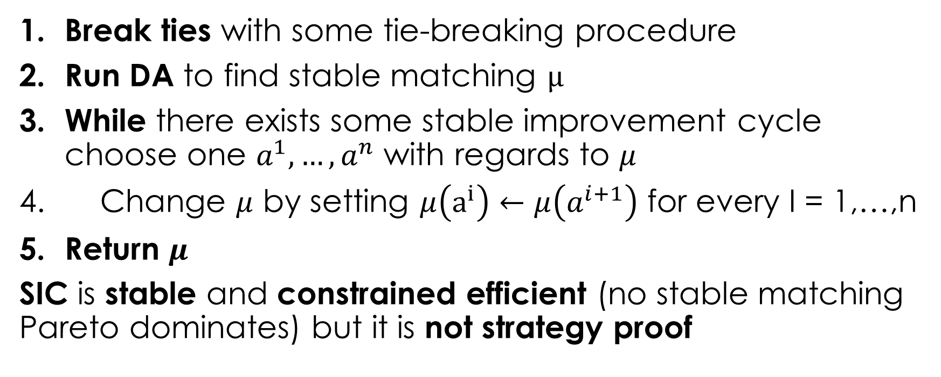
SIC algorithm
Break ties with some tie-breaking procedure
Run DA to find stable matching $μ$
While there exists some stable improvement cycle choose one $a^{1},…,a^{n}$ with regards to $μ$
Change $μ$ by setting $μ\left(a^{i}\right)←μ\left(a^{i+1}\right)$ for every I = 1,…,n
Return $μ$
SIC is stable and constrained efficient (no stable matching Pareto dominates) but it is not strategy proof

Slide 37
Example (all capacities are 1)
We won’t run this example, but this is the kind of situation you can expect in real life:
Priority classes like the above are guarantees and after running DA and determining student preferences,
SIC is run to try to swap students along a cycle and find a constrained efficient matching

Slide 38
More info on NYC (since we live here)
NYC now uses student-proposing DA, except
Students can rank only 12 schools
A few schools (Stuyvesant, Bronx Science) get filled first using examinations.
Some top students automatically get first choice.
Unmatched students go to a second round, which uses random serial dictatorship.
In first year of new program
More than 70,000 got one of their choice schools.
Another 7,600 got a choice school in RSD stage
Just 3,000 were left, down from 30,000.

